Slide 1
Building Geography
Skills
Day 5

Slide 2
Word Splash
Write all the words your teacher tells you.
Underline any word for which you are not sure of the spelling.
Circle any word for which you are not sure of the meaning.

Slide 3
Word Splash
Write a brief story using all the words. The words may be in any order and you may use them as many times as you would like. You may also change the ending of the word if it helps. It needs to be at least 7 lines long.

Slide 4
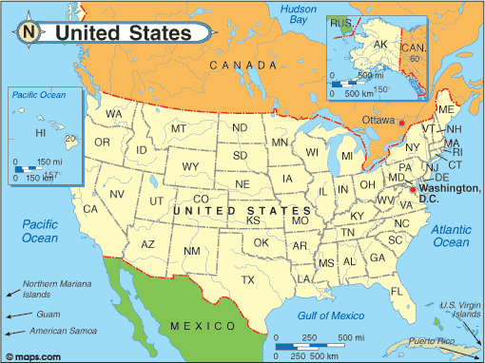
Title
Tells what the map is about

Slide 5
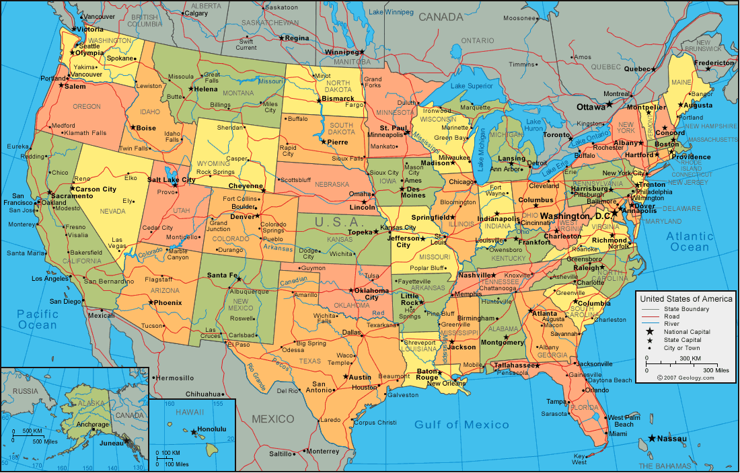
Political Map
Shows the location of cities, states, and countries

Slide 6
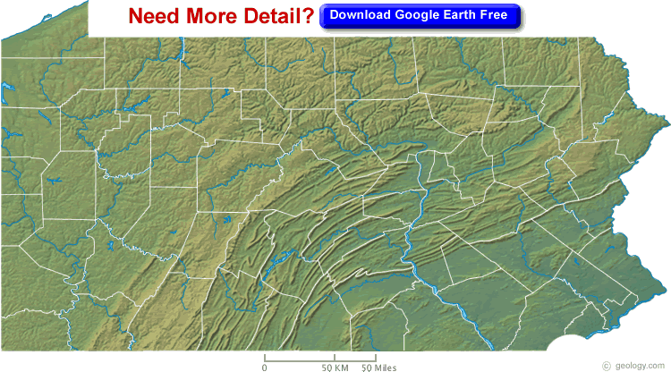
Physical Map
Shows landforms such as mountains and rivers

Slide 7
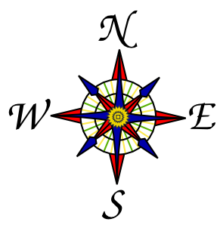
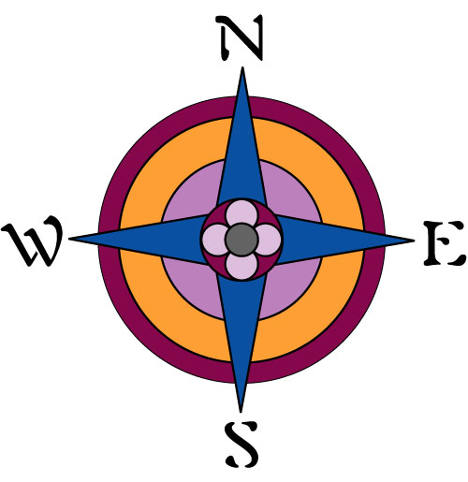
Compass Rose
A decorative pointer that shows the four major directions

Slide 8
Cardinal
Directions
The four major directions:
North, South, East, West

Slide 9
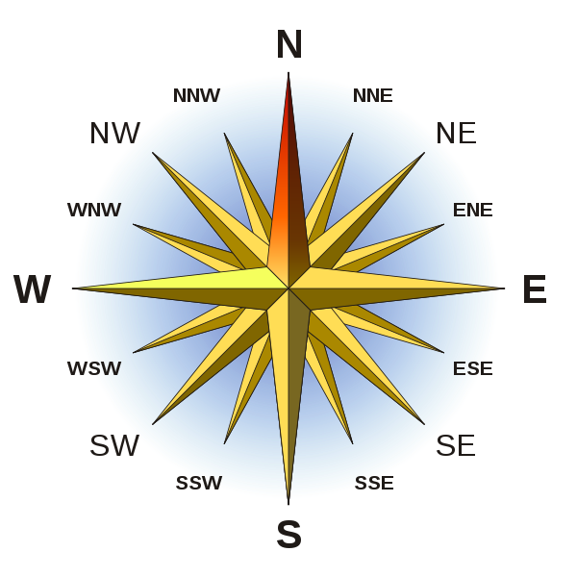
Intermediate
Directions
The pointers halfway between the cardinal directions:
Northeast, Southeast, Southwest, Northwest

Slide 10
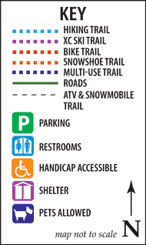
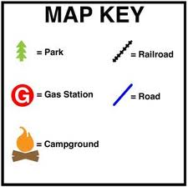
Symbols
A mark, drawing, or color that stands for something on a map.

Slide 11
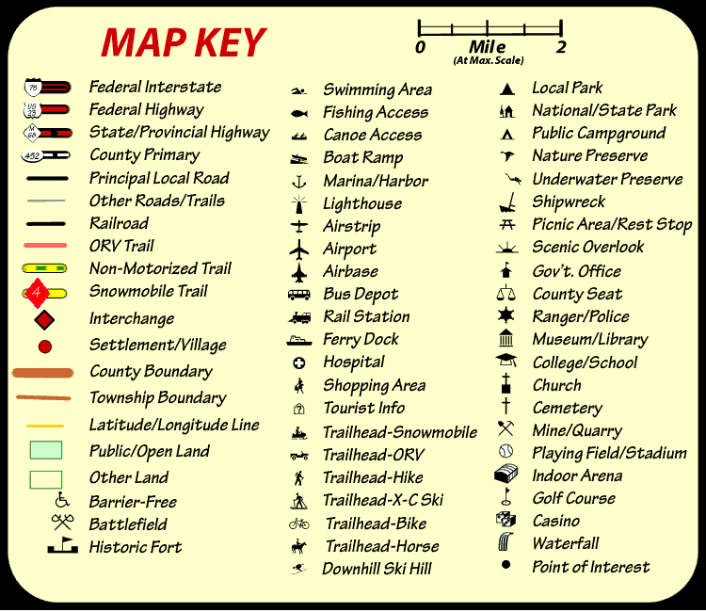
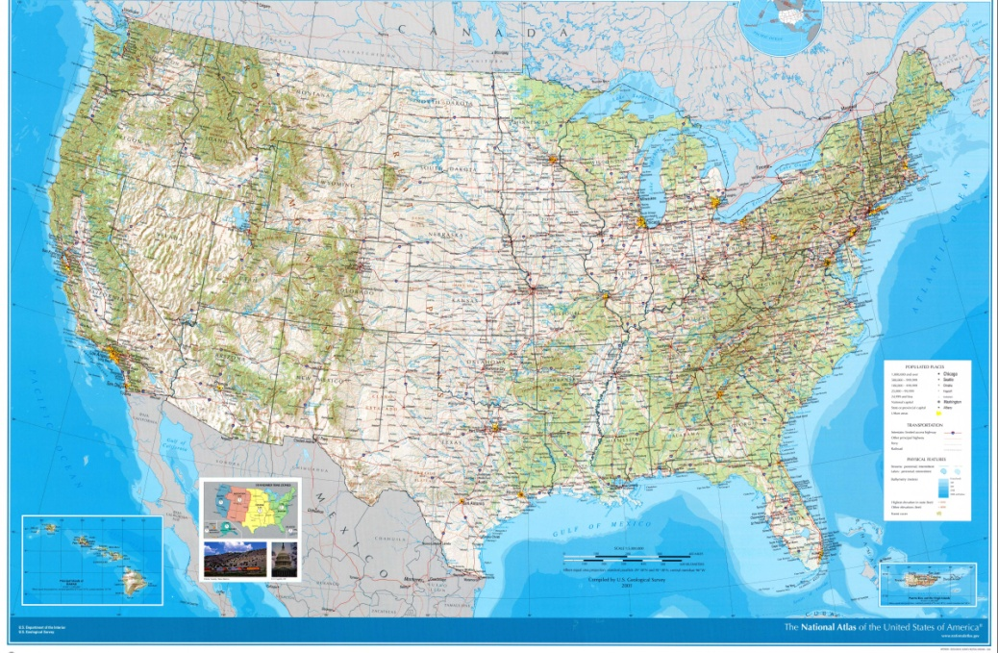
Map Key
Also called a legend. Shows what symbols in a map stand for.

Slide 12
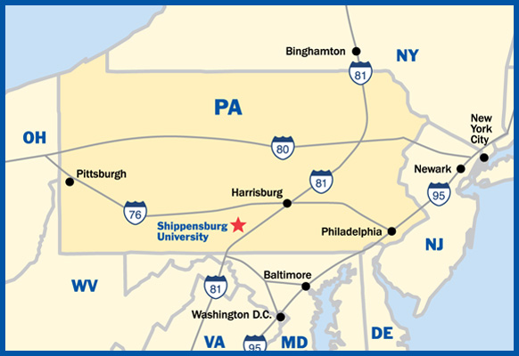
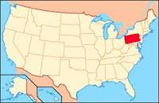
Locator
A small globe or map found in a corner that shows you where the main map is located within an area of the Earth

Slide 13
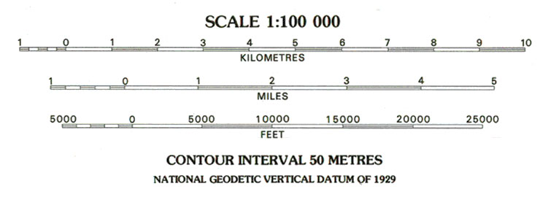
Scale
Helps us figure out how far it is in real miles or kilometers from one point on a map to another

